Slide 1
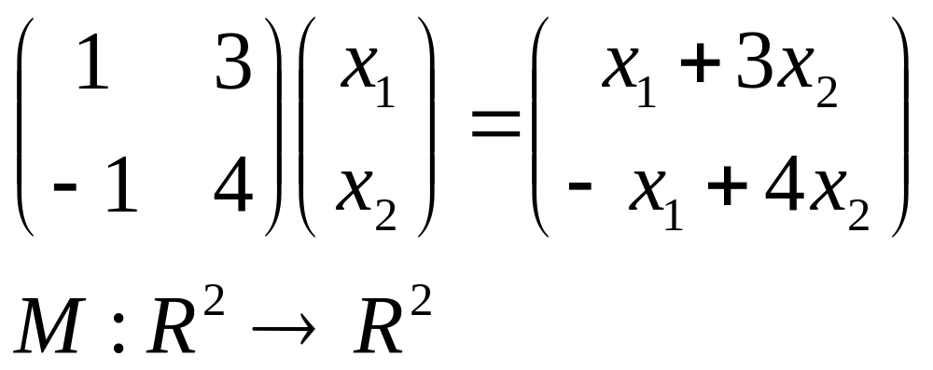

Slide 2
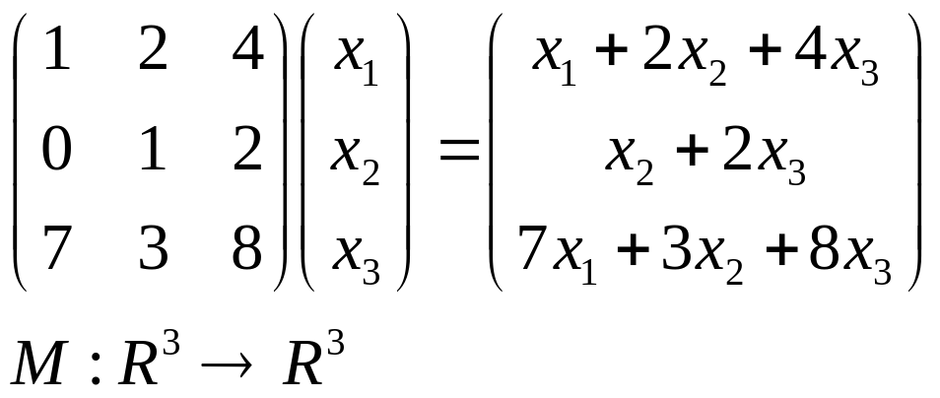

Slide 3
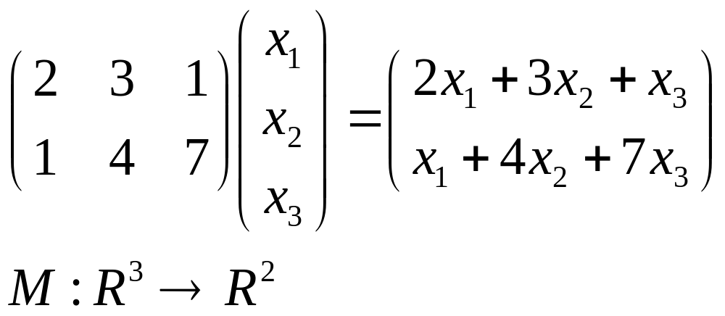

Slide 4
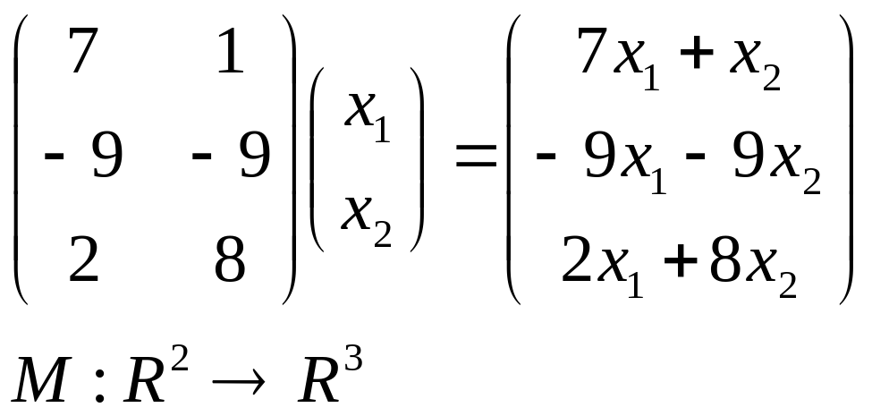

Slide 5
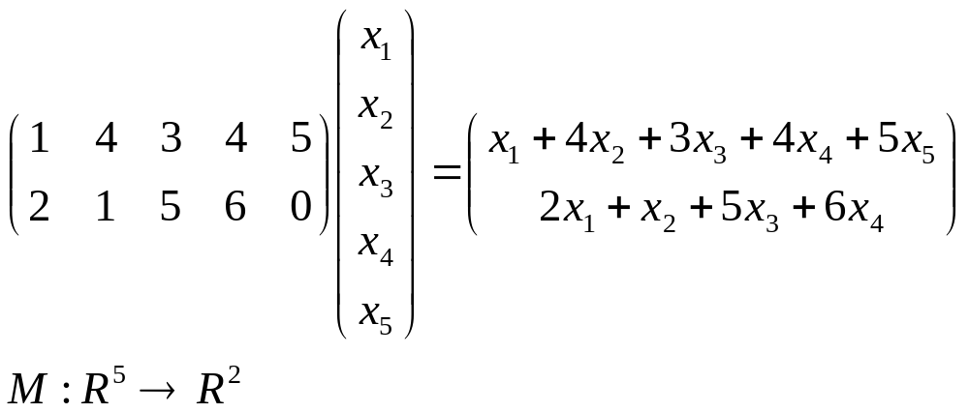

Slide 6
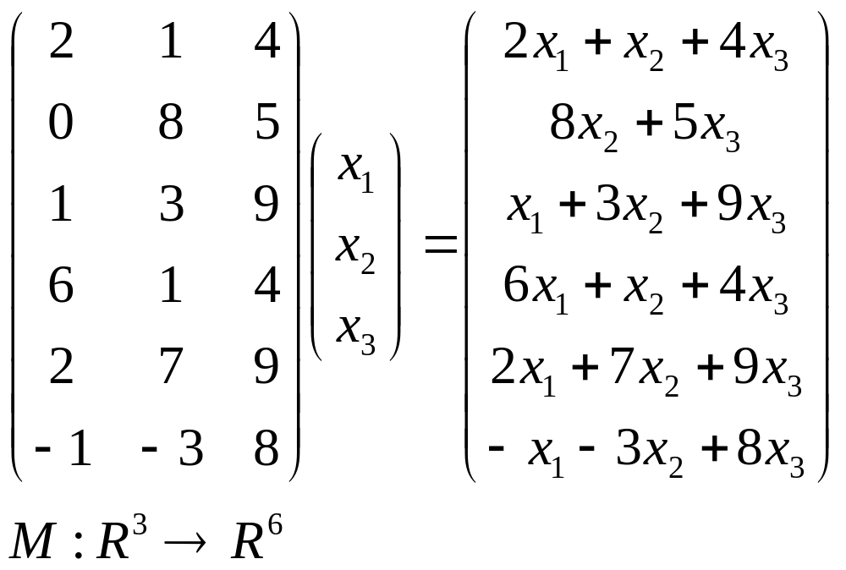

Slide 7
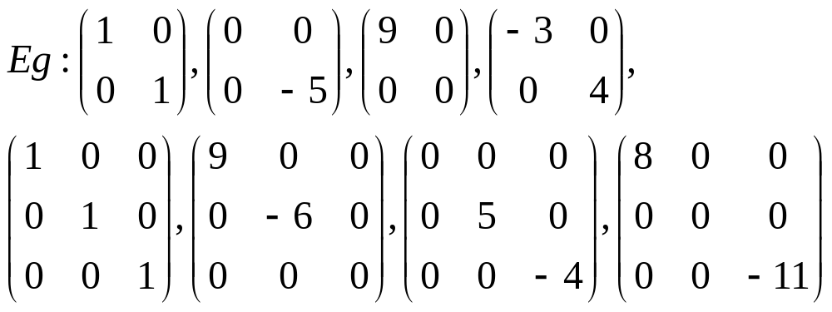

Slide 8
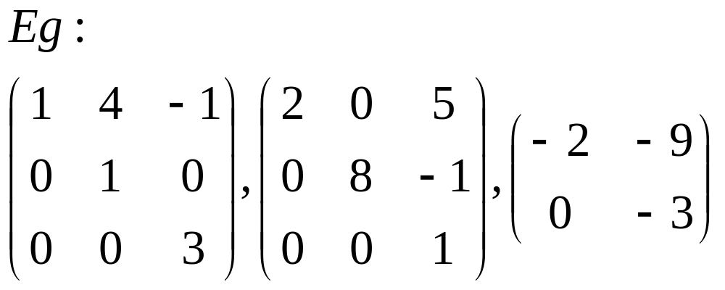

Slide 9
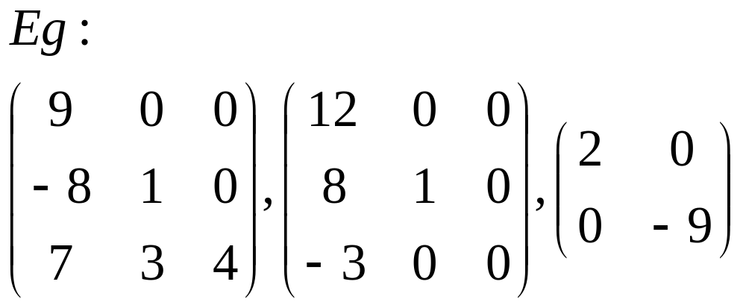

Slide 10
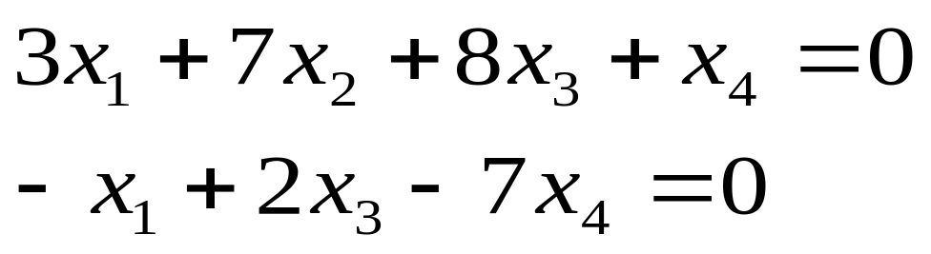
is a homogeneous system.

Slide 11
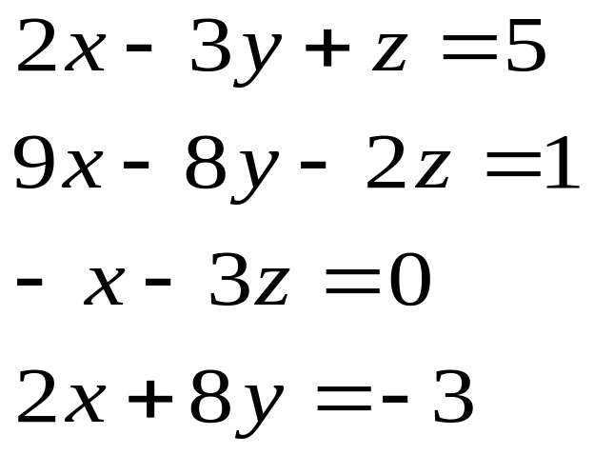
is not a homogeneous system.

Slide 12
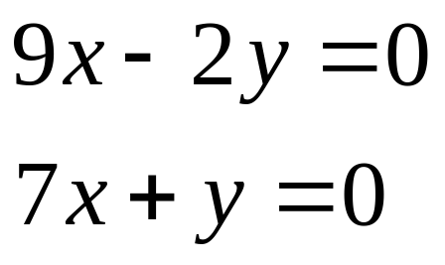
is a homogeneous system.

Slide 13
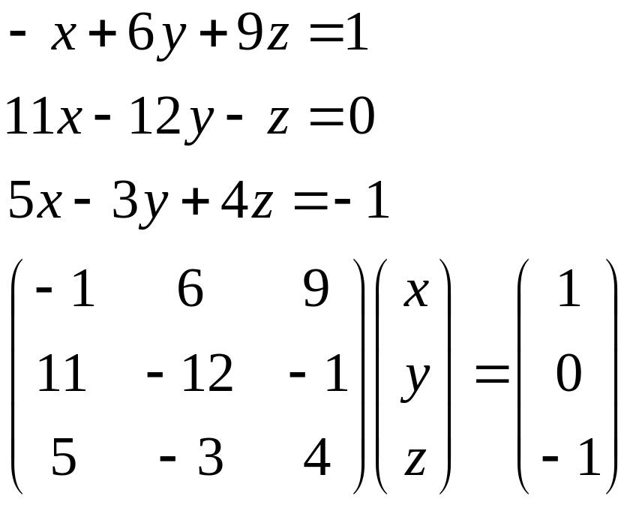
Eg: The system

Slide 14
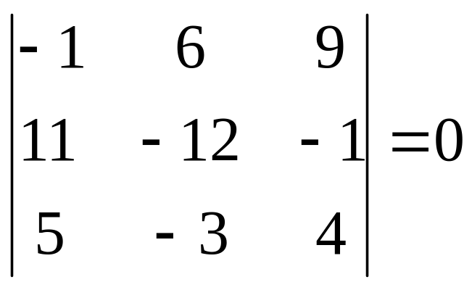
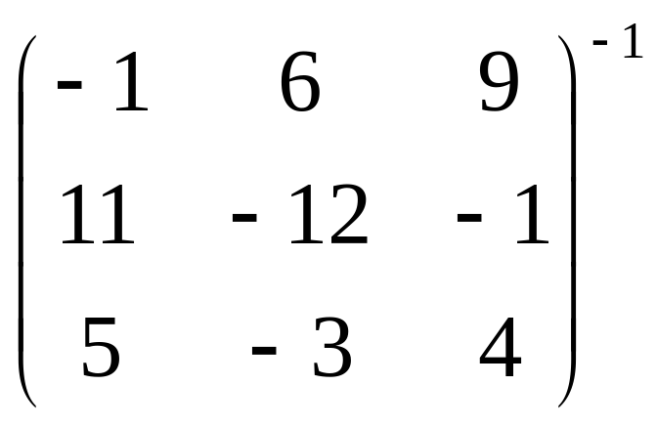
has either no solutions or infinitely many solutions
since
which implies
doesn’t exist.

Slide 15
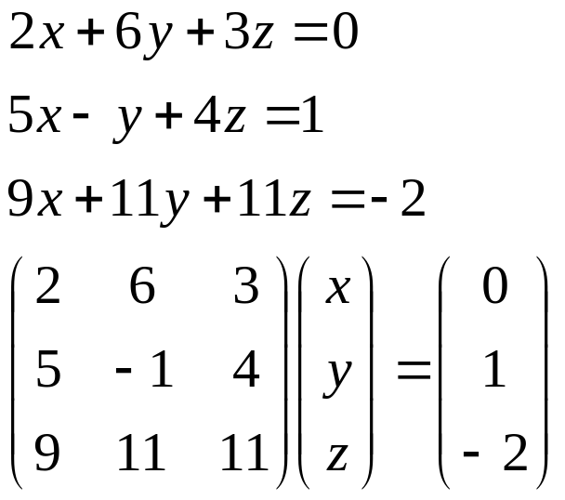
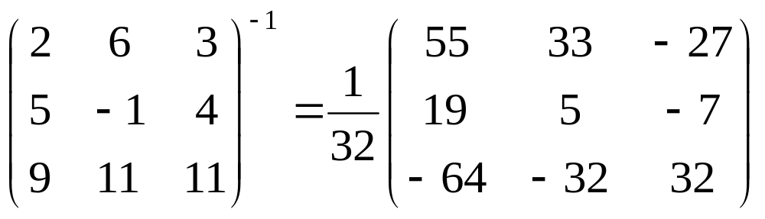
The system
has a unique solution since

Slide 16
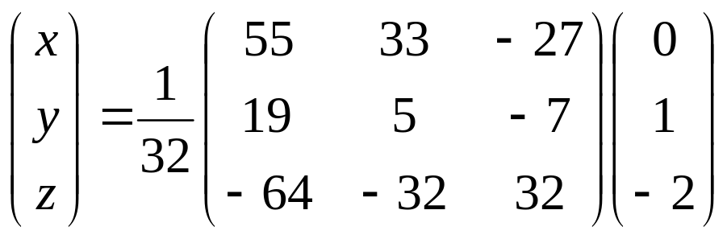
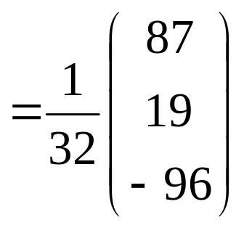
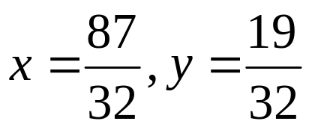

and this solution is
or
and

Slide 17
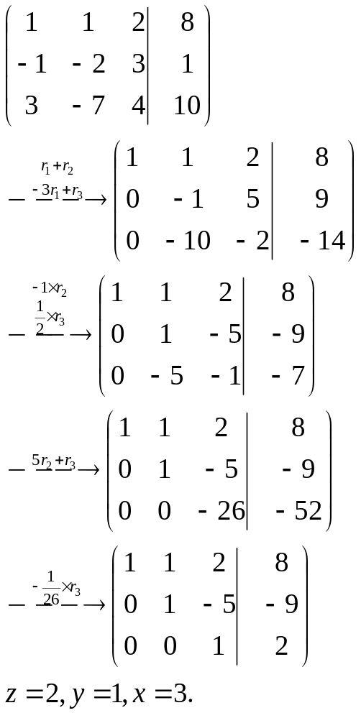

Slide 18
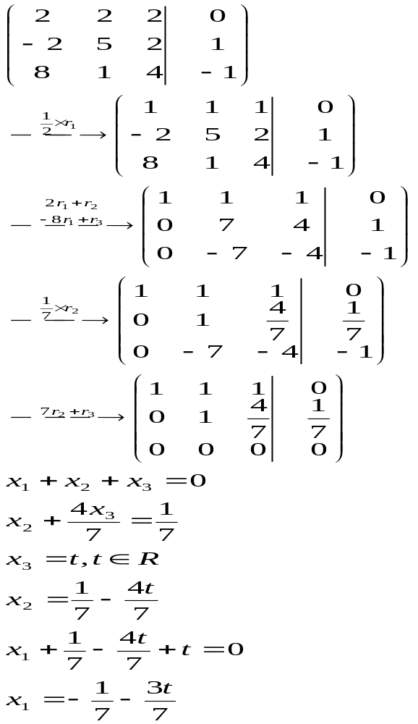
Let

Slide 19
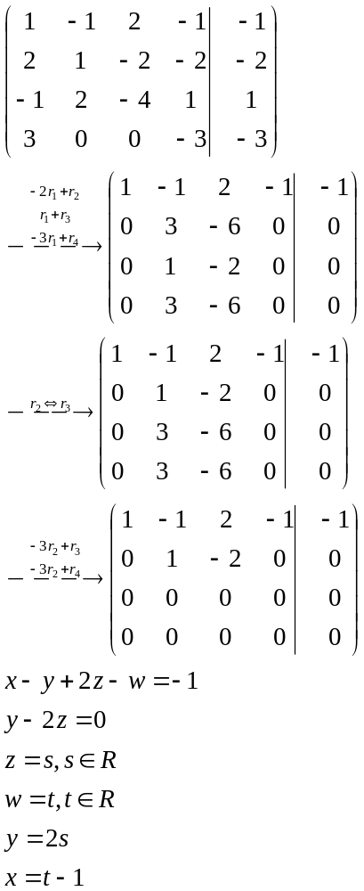
Let
and

Slide 20
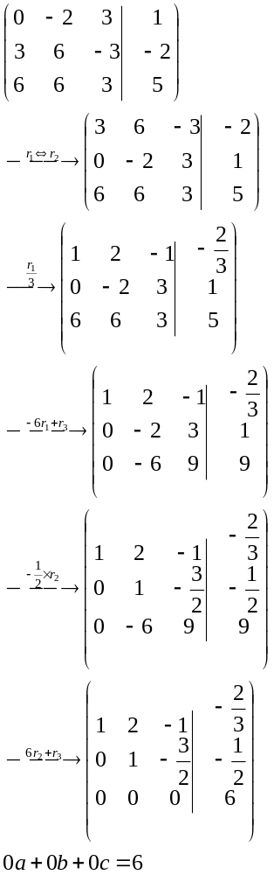
no solution.

Slide 21
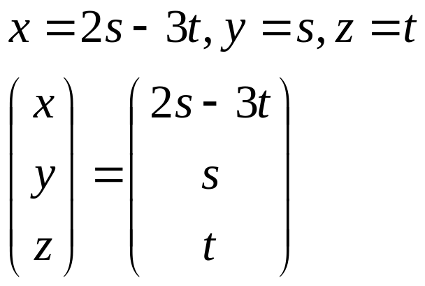
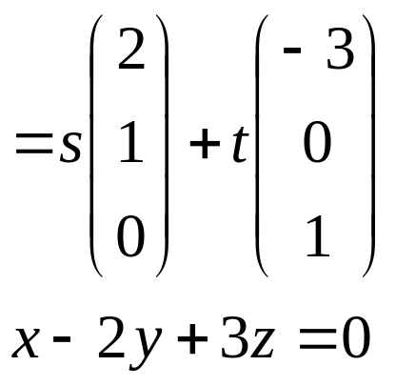
A plane.

Slide 22
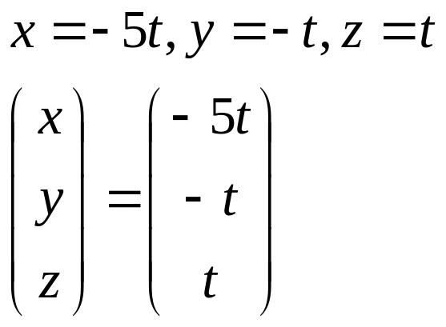
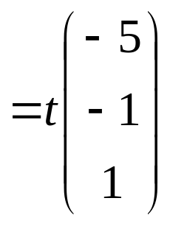
A line.

Slide 23
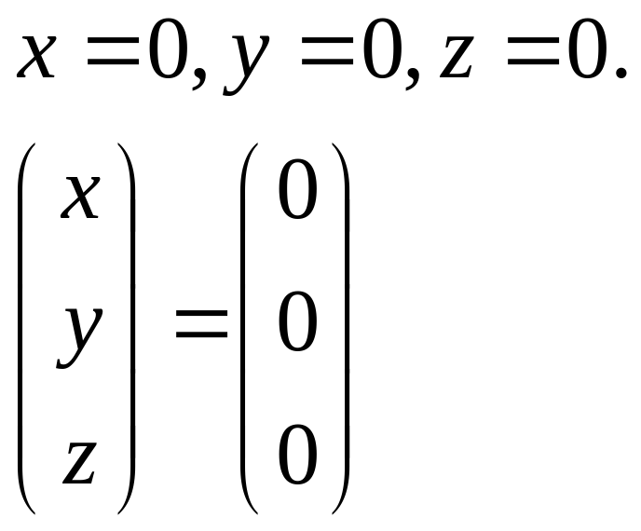
0.

Slide 24
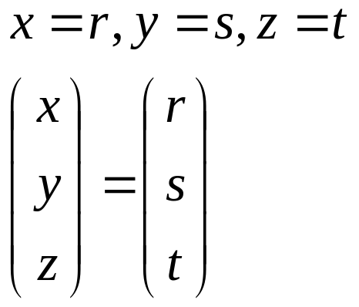
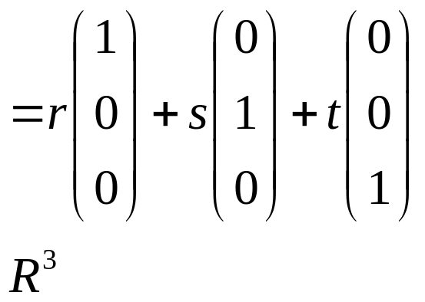
itself.

Slide 25
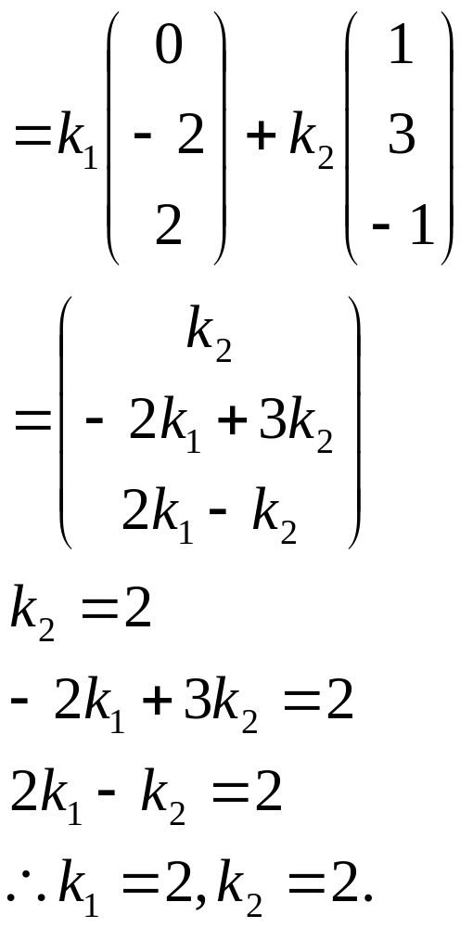

Slide 26
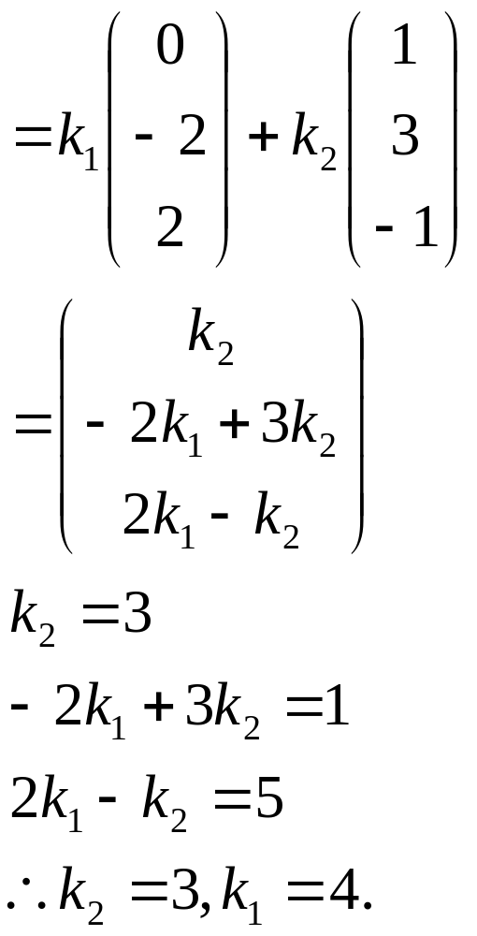

Slide 27
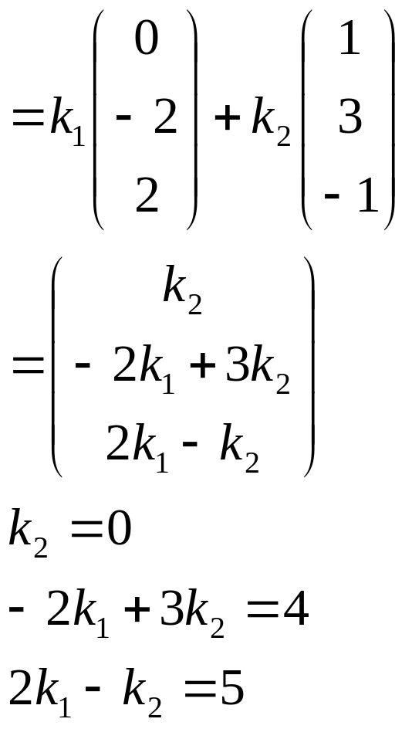
no solution.

Slide 28
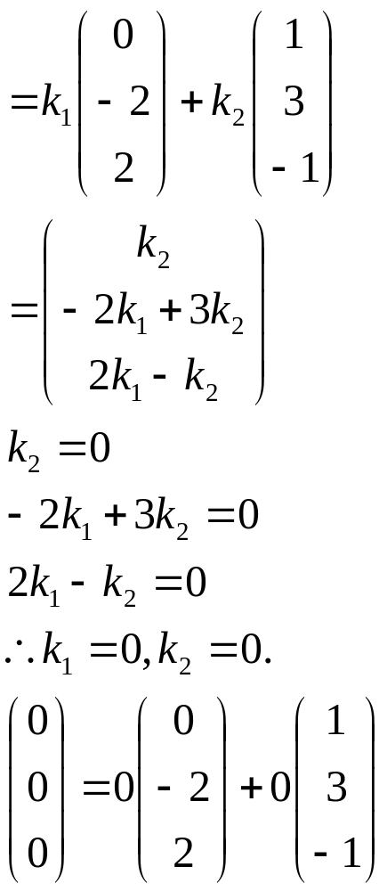

Slide 29
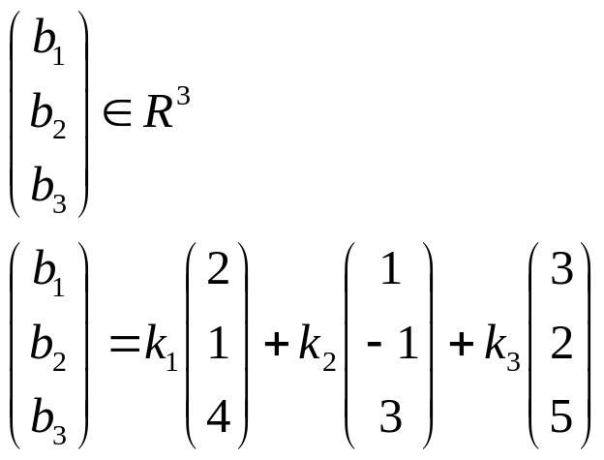
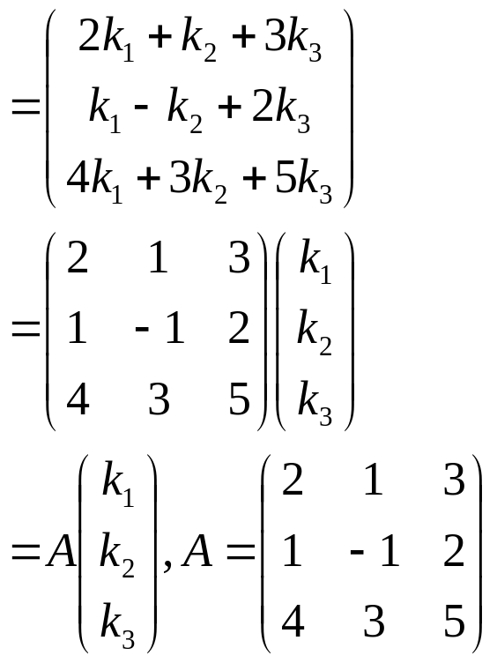
If
and
|A| = -22+3+21
= 2

Slide 30
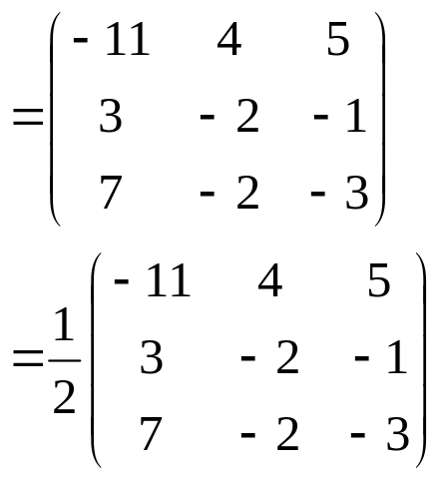
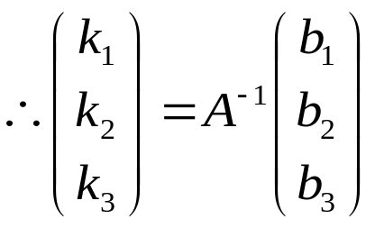
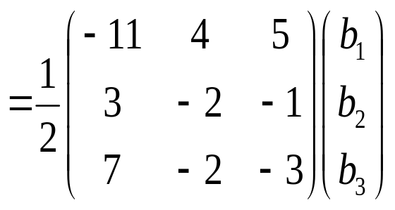
adj A
A⁻¹

Slide 31
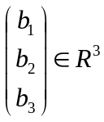

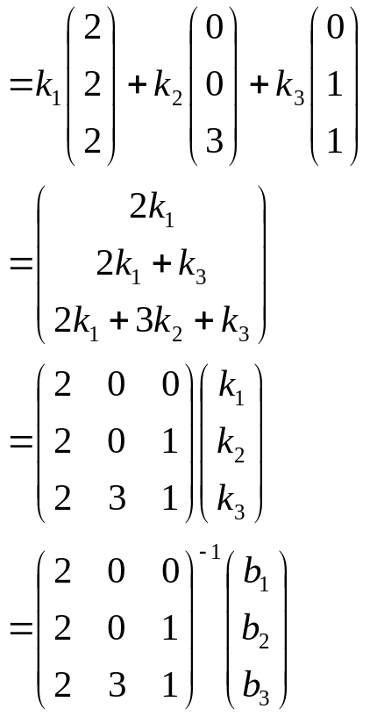

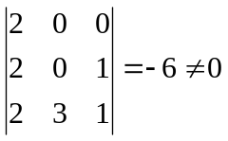
If
and
= k₁v₁ + k₂v₂ + k₃v₃
since
so v₁, v₂, v₃ span R³.

Slide 32
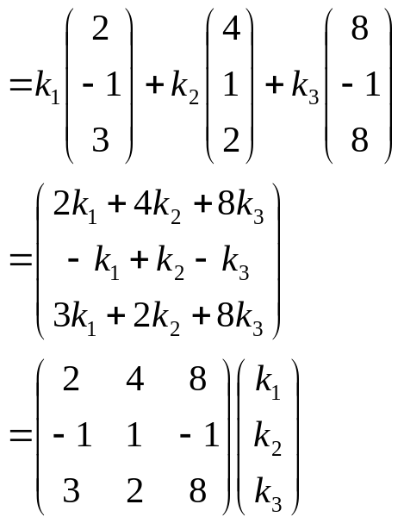
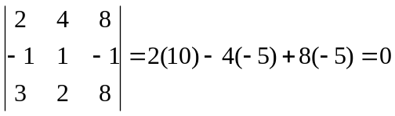
If
and
= k₁v₁ + k₂v₂ + k₃v₃
since
so v₁, v₂, v₃ do not span R³.

Slide 33
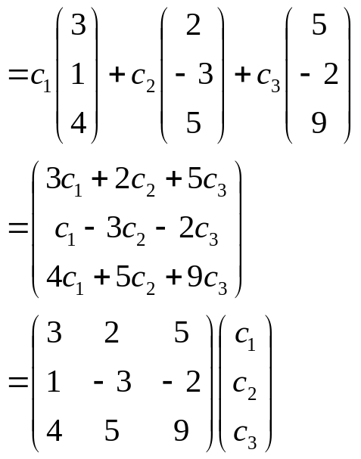
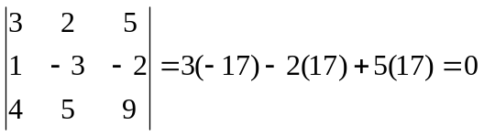
If
and
= k₁v₁ + k₂v₂ + k₃v₃ + k₄v₄
= k₁v₁ + k₂v₂ + k₃v₃ + k₄(v₁ – v₂)
= (k₁ + k₄)v₁ + (k₂ – k₄)v₂ + k₃v₃
= c₁v₁ + c₂v₂ + c₃v₃
since
so v₁, v₂, v₃, v₄ do not span R³.

Slide 34
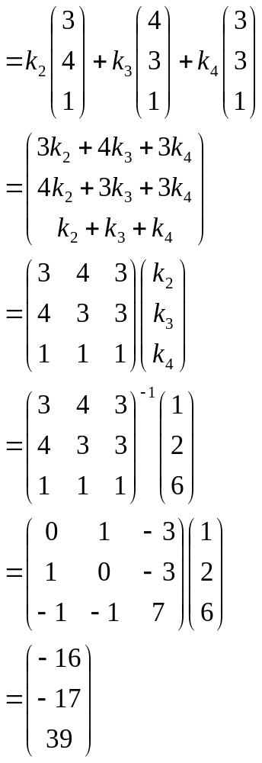


V₁ = k₂v₂ + k₃v₃ + k₄v₄
V₁ = -16v₂ -17v₃ + 39v₄

Slide 35
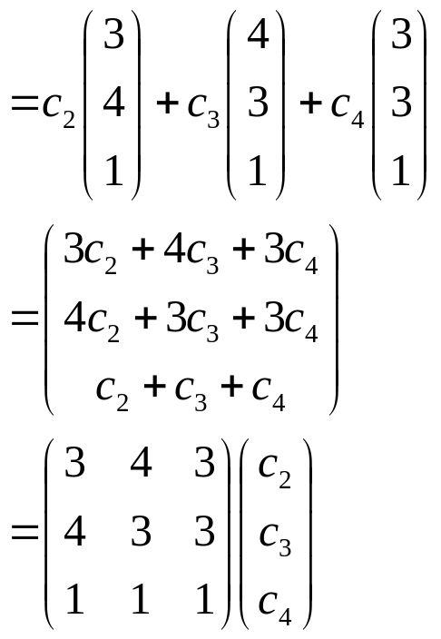
If
and
= k₁v₁ + k₂v₂ + k₃v₃ + k₄v₄
= k₁(-16v₂ - 17v₃ + 39v₄) + k₂v₂ + k₃v₃ + k₄v₄
= (k₂ -16k₁)v₂ + (k₃ – 17k₁)v₃+ (39k₁ + k₄)v₄
= c₂v₂ + c₃v₃ + c₄v₄

Slide 36
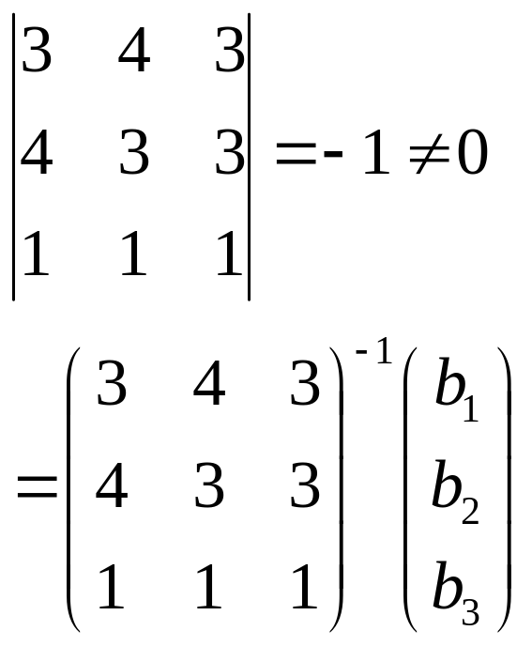

Since
v₁, v₂, v₃, v₄ span R³.

Slide 37


Slide 38

linearly dependent.

Slide 39

linearly independent.

Slide 40

linearly independent.

Slide 41

linearly independent.

Slide 42

linearly independent.

Slide 43

linearly dependent.

Slide 44


Slide 45


If

Slide 46


Slide 47

If

Slide 48

The vectors are linearly dependent.

Slide 49

If
The vectors do not span R³.

Slide 50

The vectors are linearly dependent.

Slide 51

If
The vectors do not span R³.

Slide 52


Basis:
Dimension: 2

Slide 53


Basis:
Dimension: 1

Slide 54

No basis.
Dimension: 0

Slide 55


Basis:
Dimension: 1

Slide 56


Slide 57


Basis:
Dimension: 2

Slide 58


Slide 59


Basis:
Dimension: 3

Slide 60




Slide 61




Slide 62


Slide 63




Slide 64


Slide 65



r₁ = (1, -1, 3)
r₂ = (0, 1, -19)
c₁
c₂
rank (A) = 2
nullity (A) = 1

Slide 66


Slide 67



r₁
c₁
rank (A) = 1
nullity (A) = 2

Slide 68


Slide 69




r₁
r₂
c₁
c₂
rank (A) = 2
nullity (A) = 2

Slide 70


Slide 71





r₁ = (1, 4, 5, 6, 9)
r₂ = (0, 1, 1, 1, 2)
c₁
c₂
rank (A) = 2
nullity (A) = 3

Slide 72


Slide 73





Slide 74






r₁ =
r₂ =
r₃ =
c₁ =
c₂ =
c₃ =
rank (A) = 3
nullity (A) = 2

Slide 75


Slide 76



rank (A) = 1
rank (A) = 2
rank (A) = 3

Slide 77




Slide 78



rank (A) = 2
rank (A) = 2
rank (A) = 3

